Slide 1

GAYATRI VIDYA PARISHAD COLLAGE OF ENGINEERING FOR WOMEN
(Autonomous)
(Approved by AICTE, New Delhi and Permanently Affiliated to Andhra University,
Visakhapatnam)
Madhurwada :: Visakhapatnam – 530048
Title of presentation – Drone Technology and Its Applications
Name – Nainika Manne
Roll no – 32510321012
Branch – CSE

Slide 2
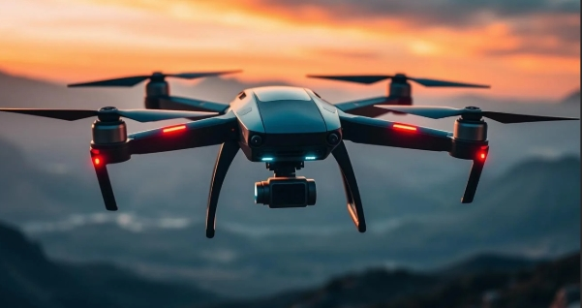
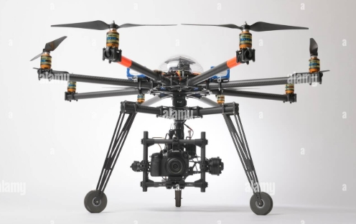
UNNAMED AERIAL VEHICALS ( UAV’S)
A UAV is an aircraft without a human pilot on board
designed to perform tasks either remotely via a ground control station or autonomously with pre-programmed routes.
UAVs vary widely in size, complexity, and functionality

Slide 3
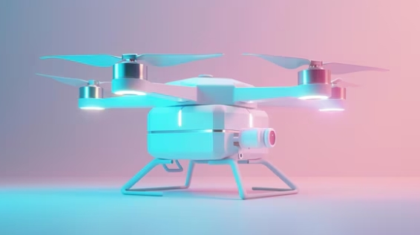
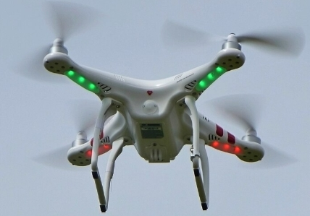
TYPES OF UAV’S
Fixed-wing UAVs
Rotary-wing UAVs
Hybrid UAVs

Slide 4
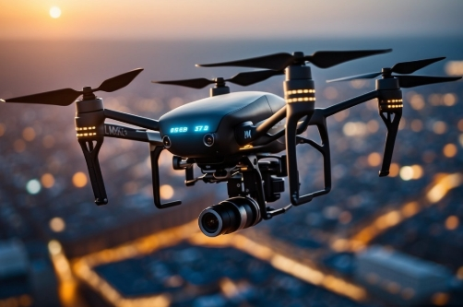
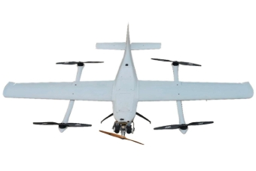
FIXED WING UAV’S
These resemble traditional airplanes with a fixed wing and are ideal for long-range flights, surveillance, and mapping. They are often used in military, agricultural, and environmental monitoring applications.

Slide 5
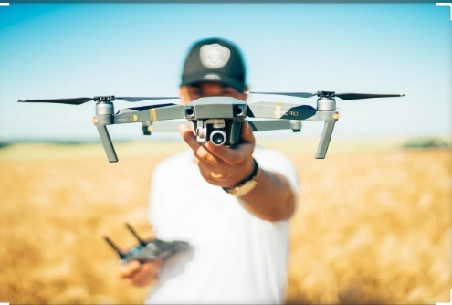
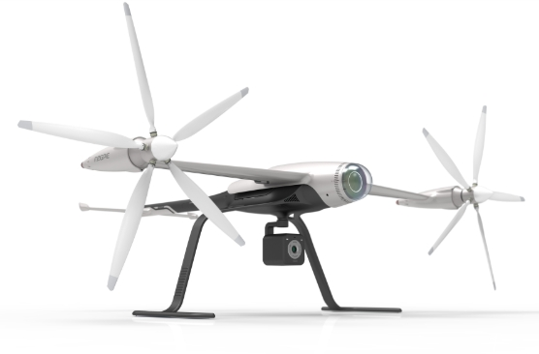
ROTATORY WING UAV’S
These include helicopters and quadcopters (with four rotors). They are highly maneuverable, suitable for tasks requiring vertical takeoff and landing (VTOL), such as aerial photography, search and rescue, and infrastructure inspections.

Slide 6
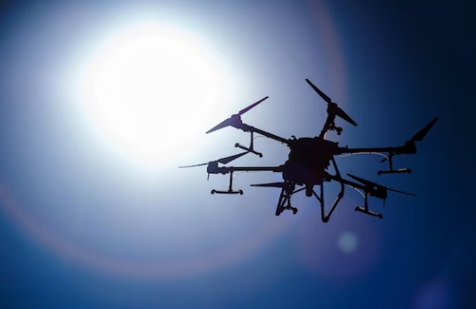
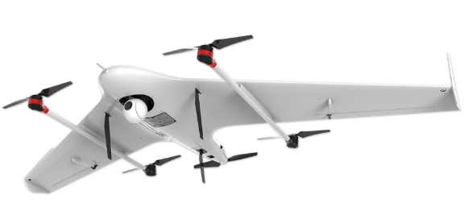
HYBRID UAV’S
Combining features of both fixed-wing and rotary-wing drones, these UAVs offer the endurance of fixed-wing aircraft with the vertical takeoff/landing capability of rotorcraft. They are useful for missions requiring flexibility, like surveillance or cargo delivery in challenging terrain.

